Slide 1
WORLD CITIES AIRLINE NETWORK ANALYSIS USING CENTRALITY MEASURES
Finding Most Influential Airport
Submitted By -
M.Tanuj BL.EN.U4AIE19041
P.Akhil BL.EN.U4AIE19049
V.Aishwarya BL.EN.U4AIE19068

Slide 2
CENTRALITY MEASURES
Graph theory
Applications
Centrality concepts

Slide 3
Betweeness centrality
Graph theory
shortest path
betweeness centrality of vertex

Slide 4
Closeness centrality
Graph
closeness centrality of a node
shortest distances

Slide 5
Degree centrality
links incident upon a node
risk of a node
directed network

Slide 6
Eigenvector centrality
influence of a node in a network
importance of neighbour nodes
Google's PageRank is a variant of the eigenvector centrality

Slide 7
TRANSPORT NETWORK ANALYSIS
Transport network analysis is used to determine the flow of vehicles (or people) through a transport network, typically using mathematical graph theory.
Transport network analysis falls within the field of transport engineering.
Influencer network analysis enables you to take a closer look at the positions of different airports in a networking. It uses algorithms like centralities to indicate the influence of each node in the network.

Slide 8
UNDERSTANDING THE PROBLEM
01
Data Acquisition and Learning
02
Representation of Data
03
Development and Explanation

Slide 9
DATA ACQUISITION AND LEARNING
Acquired from https://www.kaggle.com/divyanshrai/openflights-route-database-2014
The Open Flights/Airline Route Mapper Database contains 67663 routes between 3321 airports on 548 airlines spanning the globe
The dataset contains: Airline , IATA , Source airport, Destination airport , Airport’s city, country and geographical details.

Slide 10
REPRESENTATION
In order to represent complex data structure of a graph with various features attached to each node, networkx has been used.
pyplot : Graphing library for making interactive, publication-quality graphs online.
Also numpy and pandas packages used for plotting the graphs for data representation.

Slide 11
DEVELOPMENT AND EXPLANATION
04
LOAD DATASET
PLOT THE RELATIONSHIP
Airport data is acquired from the kaggle website
Plotting relationships among users and Unferring the result
01
03
ANALYSING THE DATASET
MEASURE EACH CENTRALITY
To find the nodes that have highest number of immediate neighbors (degree)
Performing Analysis for each type of centrality
02

Slide 12
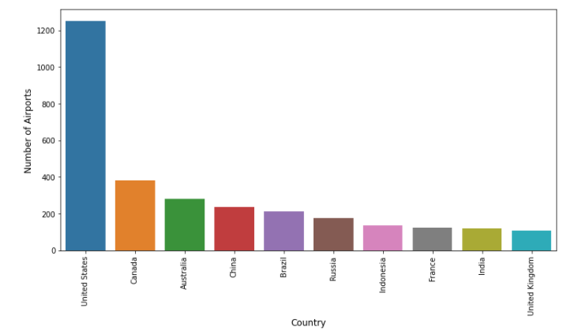
ANALYSIS

Slide 13
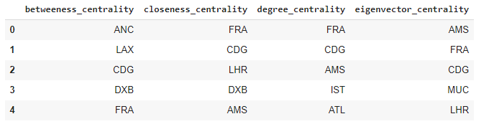

Slide 14
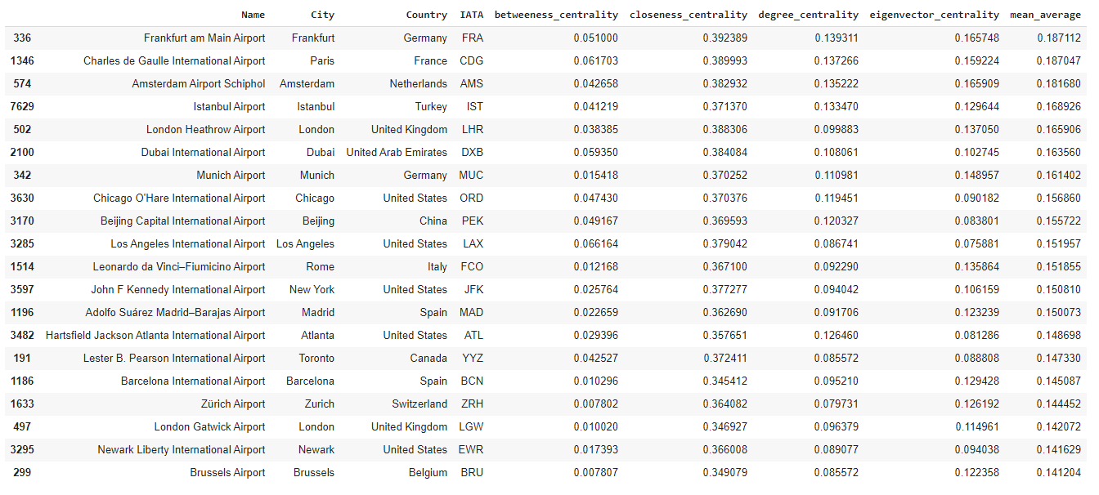
RESULTS

Slide 15
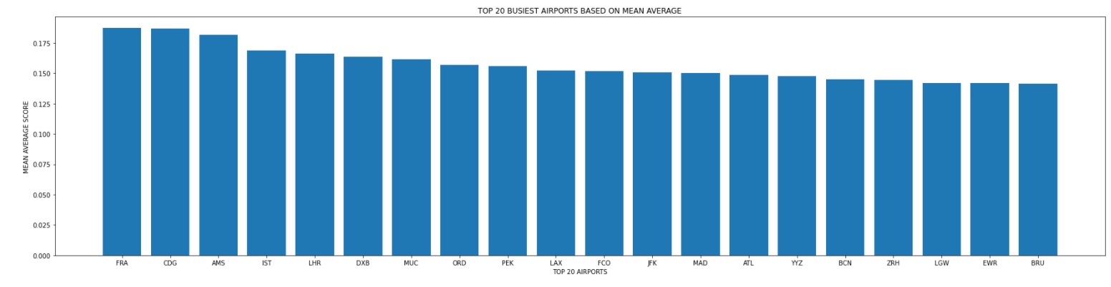

Slide 16

Thank you

